Slide 1

STRATEGY IMPLEMENTATION
Lecture Hours:50
Department of Management Studies
Visvesvaraya Technological University Belagavi-590018
Module#5
SUBJECT : MBA 205- CORPORATE STRATEGY
Free Online Lessons on Strategic Management Online Notes
Faculty of Management Studies
VTU, Belagavi

Slide 2
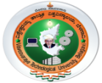
COURSE OUTLINE
Lecture | Lecture Name | Lecture Hours
#1 | Module-1 Overview of strategic management | 7
#2 | Module-2 ASSESSING EXTERNAL ENVIRONMENT | 9
#3 | Module-3 ASSESSING INTERNAL ENVIRONMENT | 9
#4 | Module-4 STRATEGY FORMULATION | 9
#5 | Module-5 STRATEGY IMPLEMENTATION | 9
#6 | Module-6 STRATEGY EVALUATION | 7
 | Total Hours | 50

Slide 3
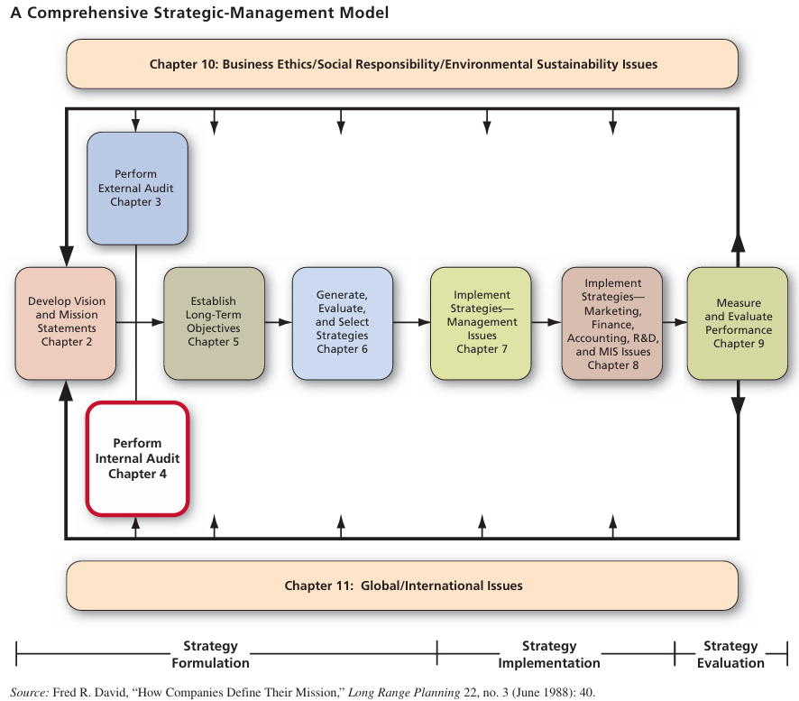
Nature of strategy implementation, issues in strategy implementation, model of strategic implementation, resource allocation, managing conflicts, restructuring, reengineering and e engineering, linking performance and pay to strategies, managing resistance to change, creating a strategy-supportive culture, and production/operations concerns in implementing strategies.

Slide 4
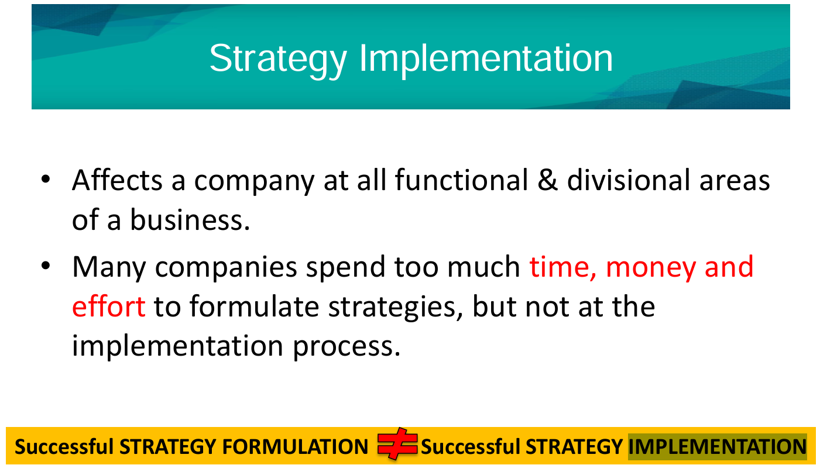

Slide 5
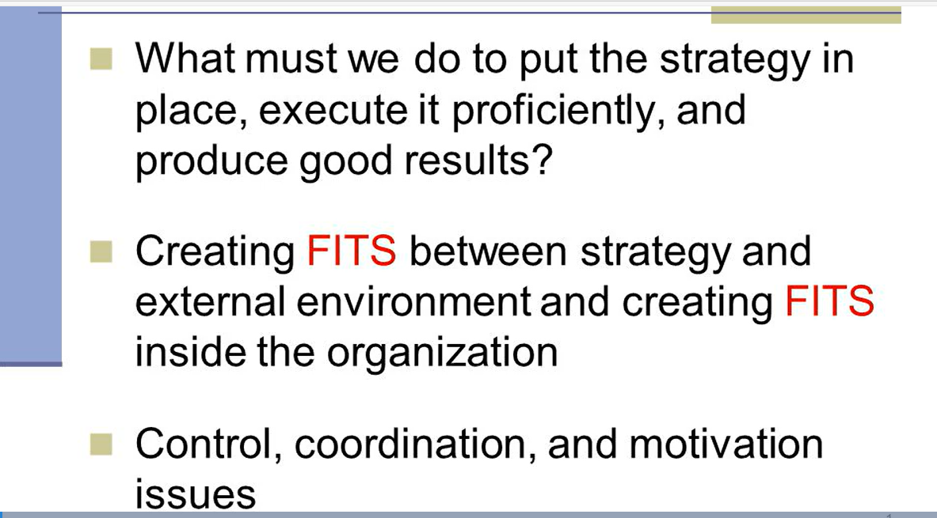

Slide 6
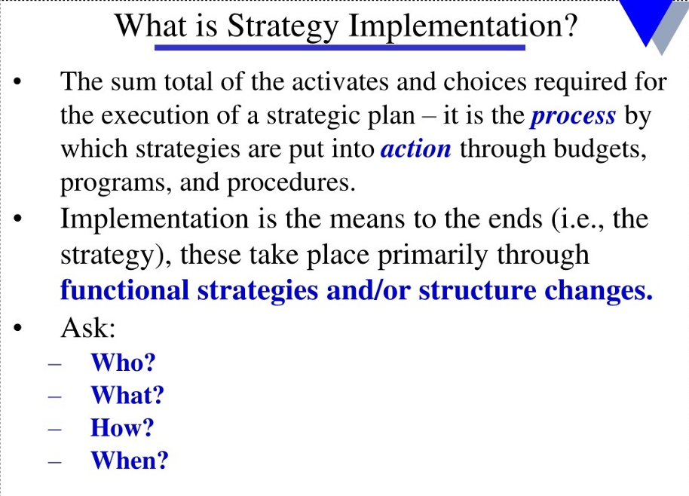

Slide 7
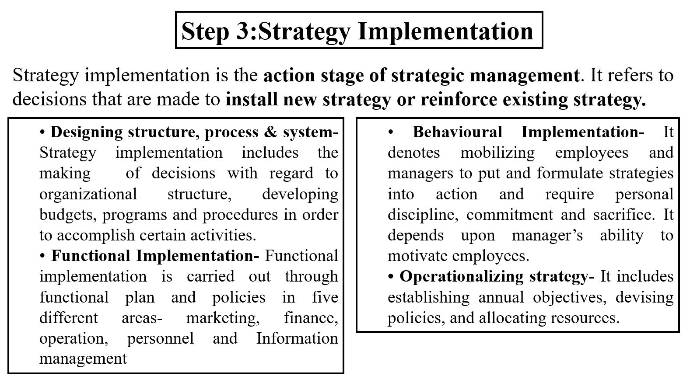

Slide 8
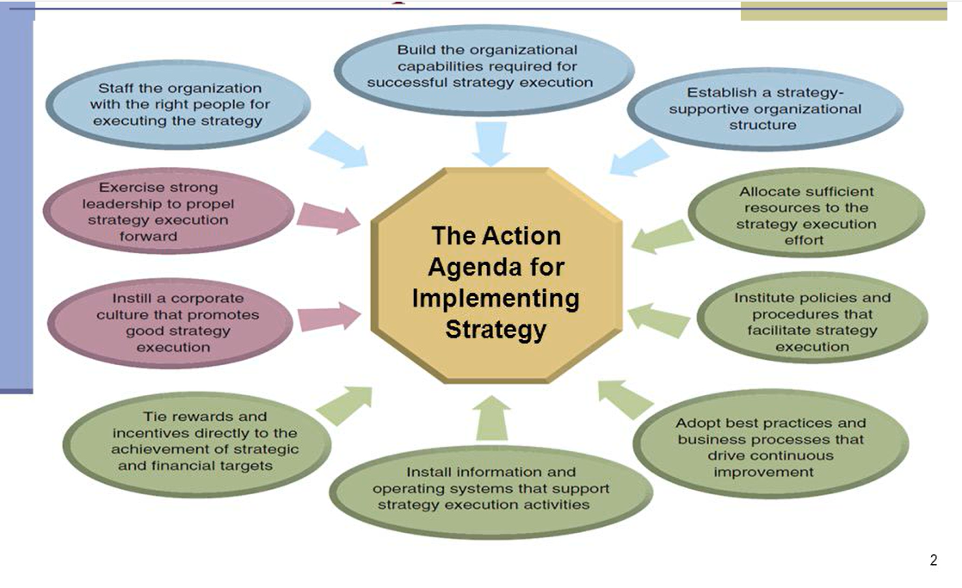

Slide 9
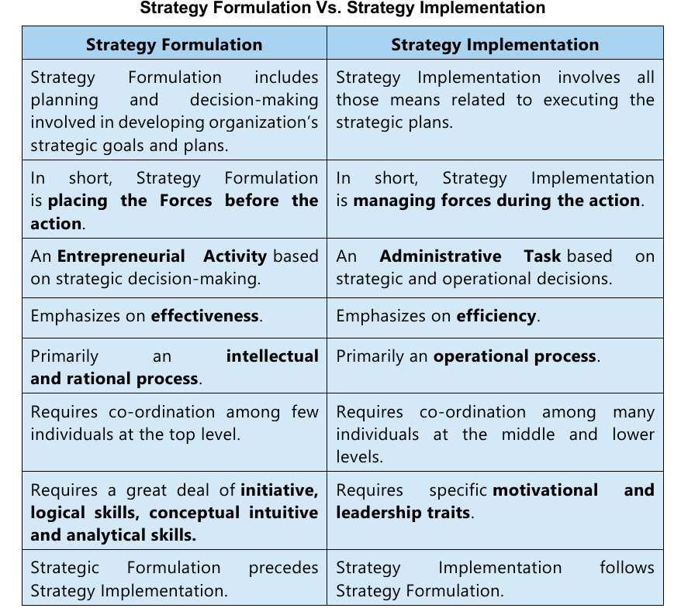

Slide 10
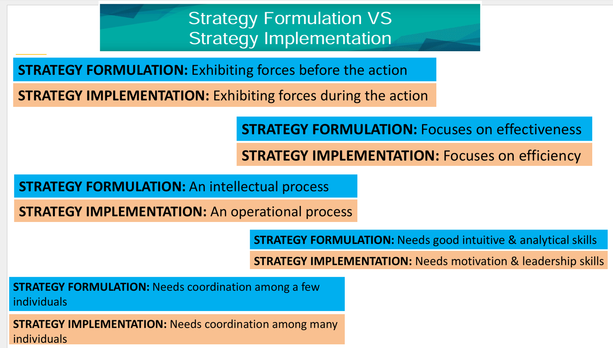

Slide 11
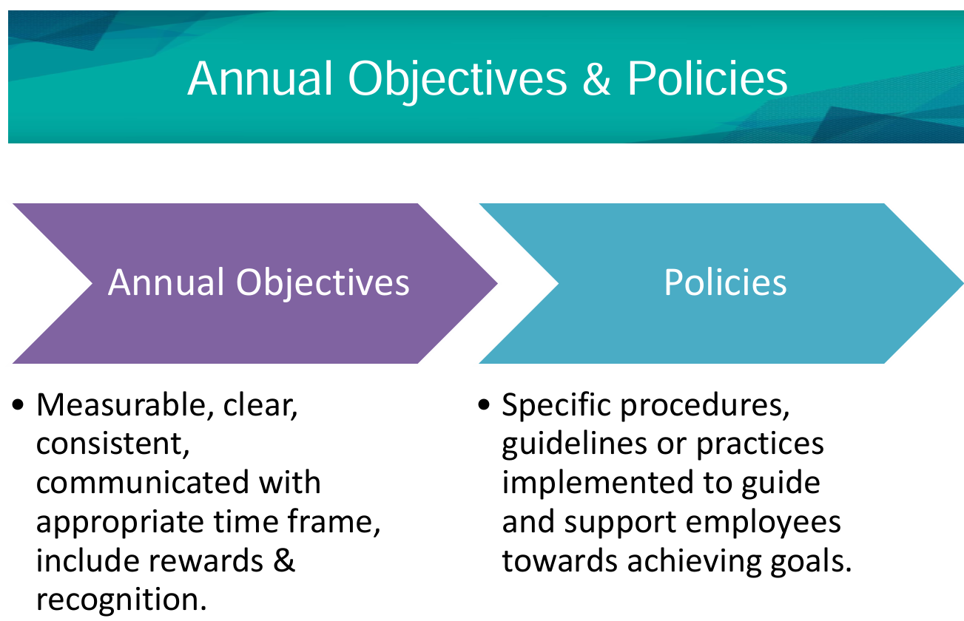

Slide 12
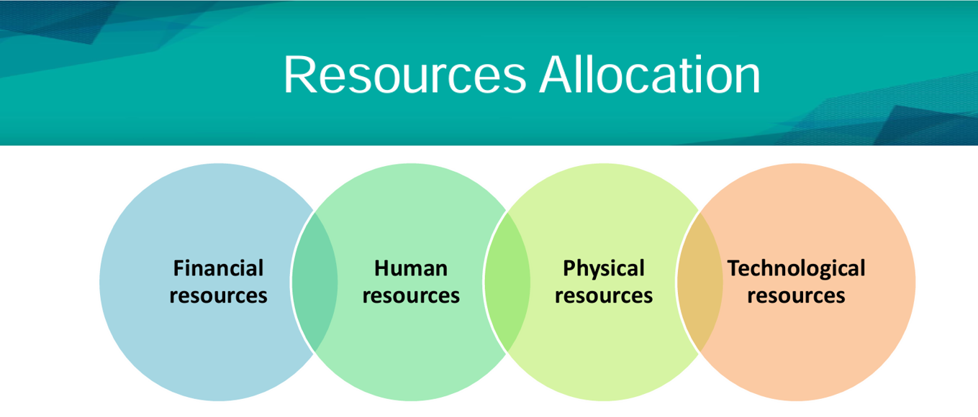

Slide 13
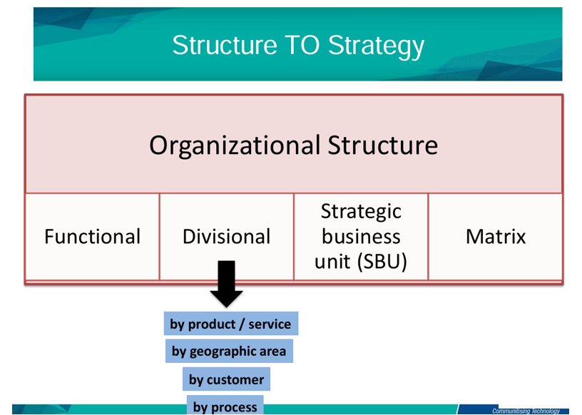

Slide 14
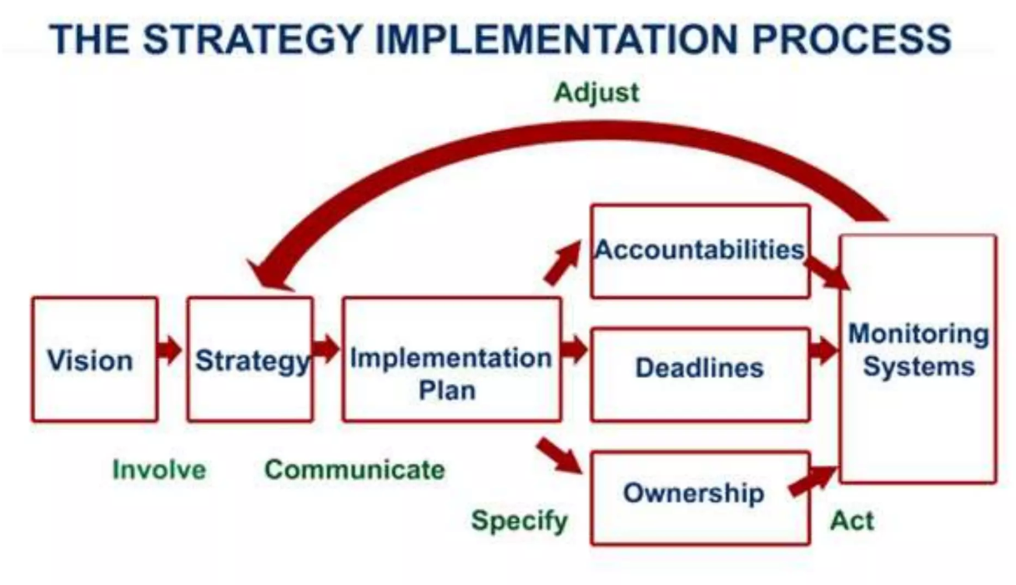

Slide 15
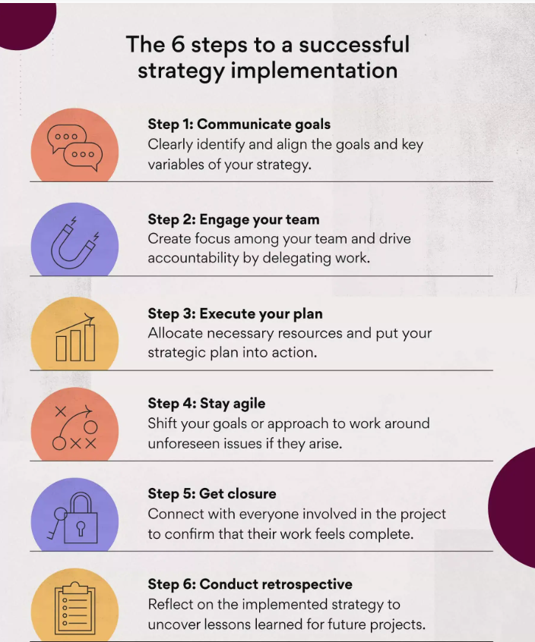

Slide 16
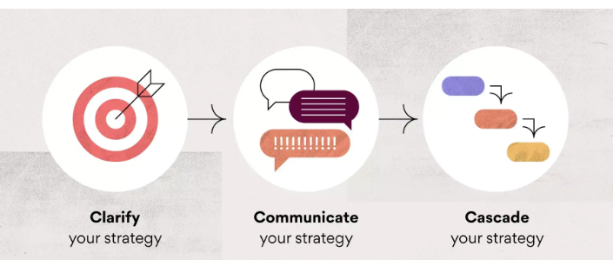

Slide 17
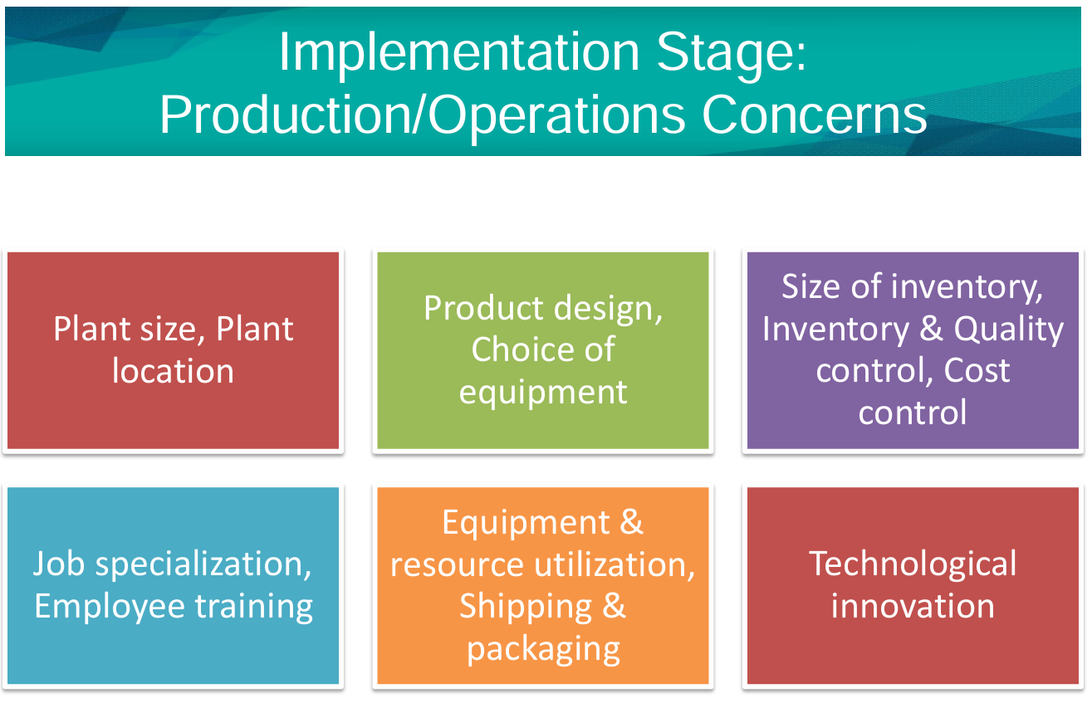
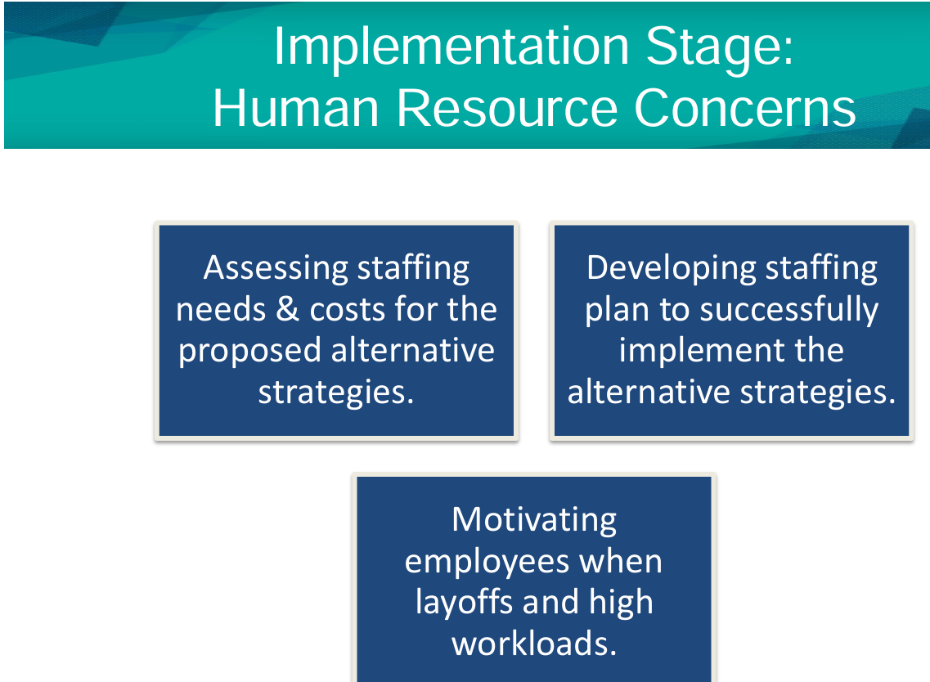
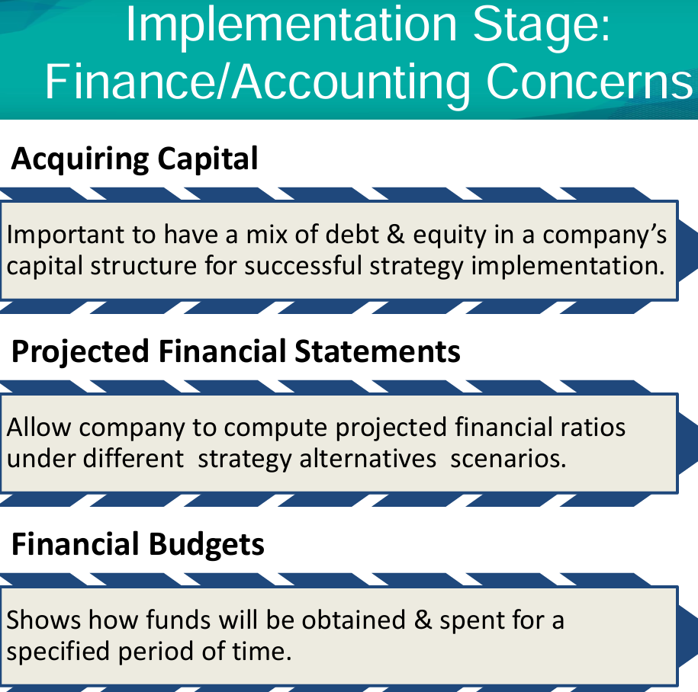
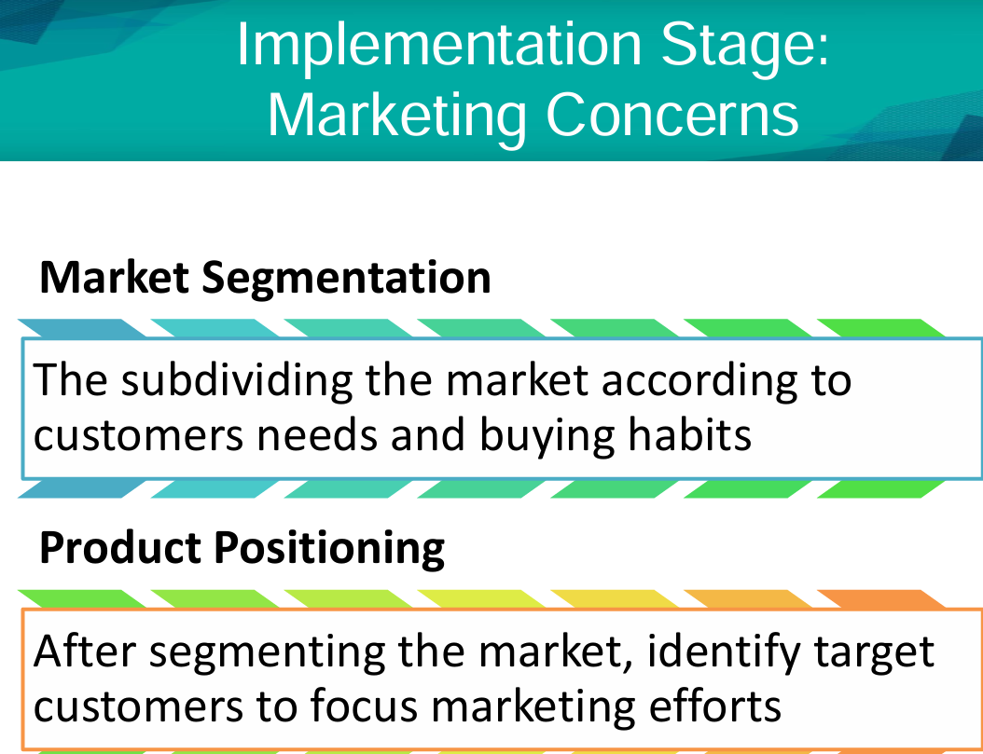

Slide 18
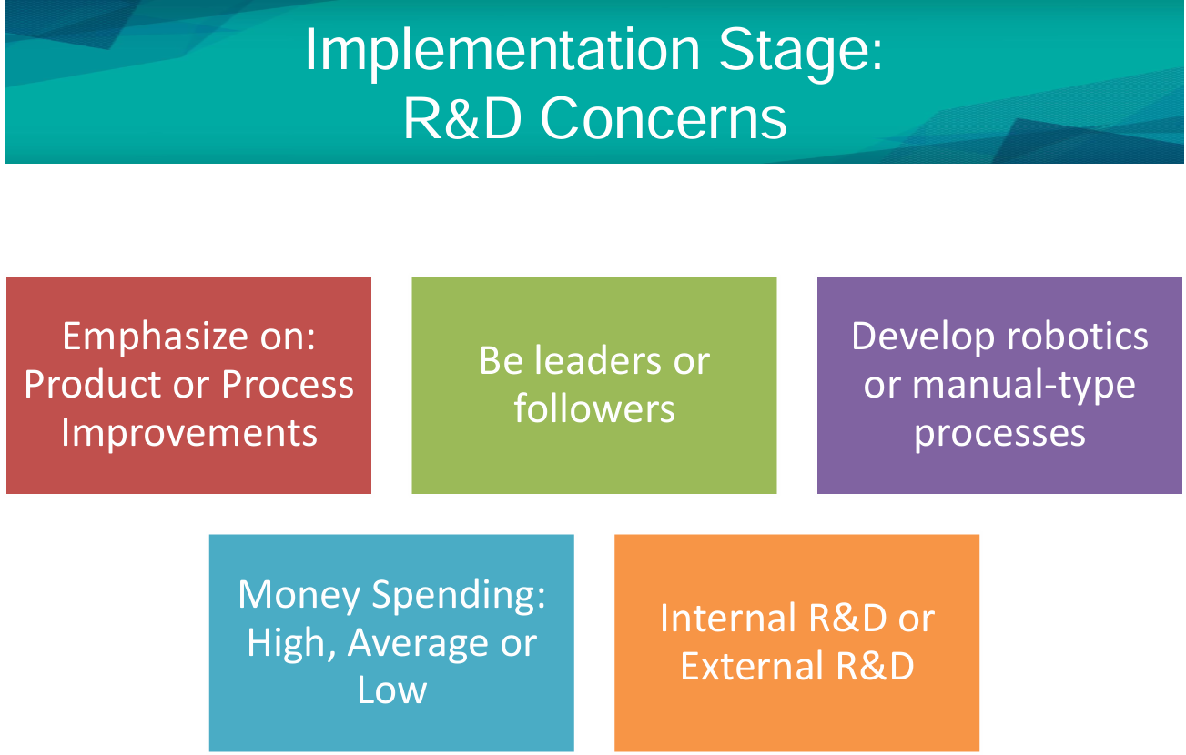
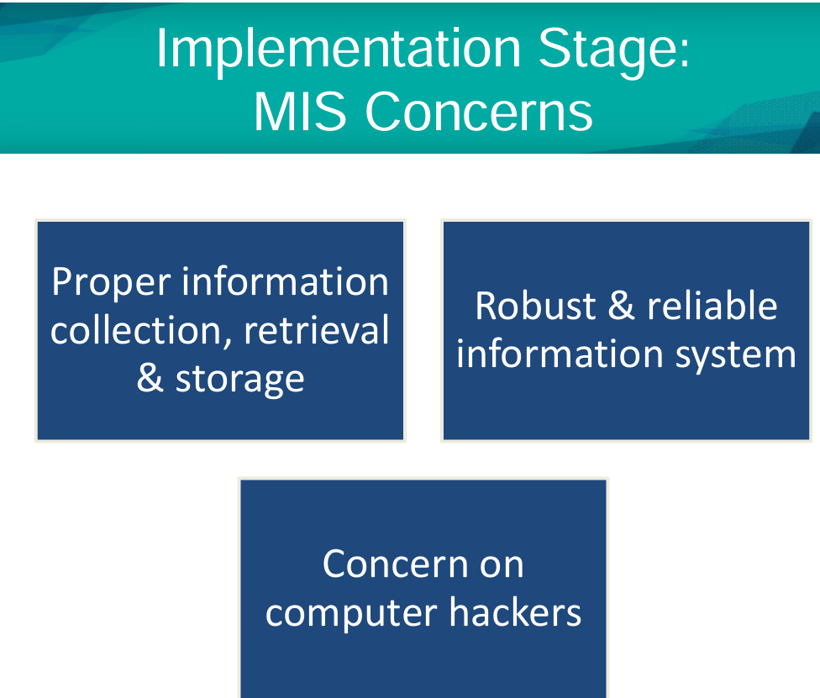

Slide 19
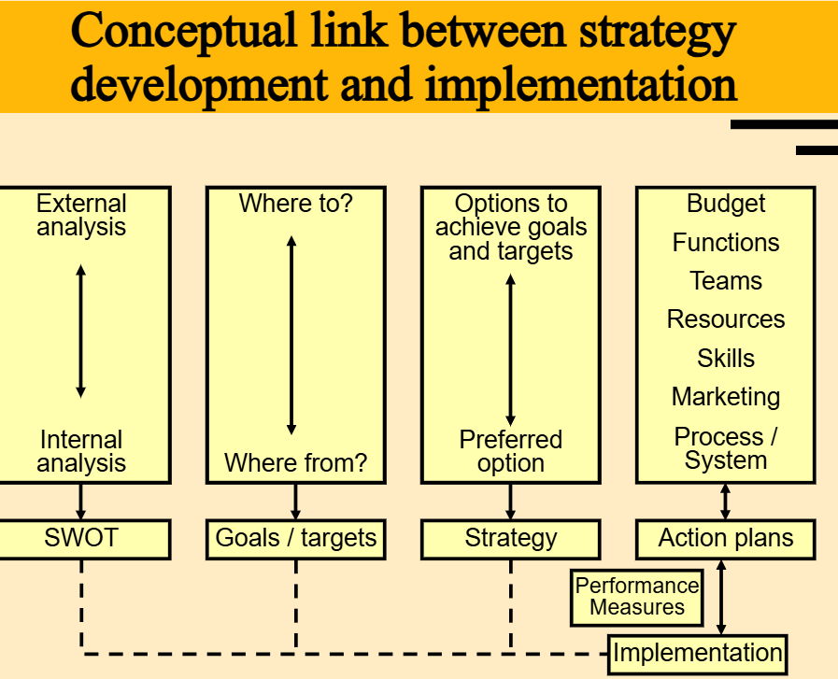

Slide 20
Meaning:
Strategy implementation is the process of putting a chosen strategic plan into action to achieve organizational goals and objectives. It involves converting strategic plans into actionable steps and ensuring that the necessary resources, structures, systems, and people are aligned and working together effectively.
In simple terms, strategy implementation means "making the strategy work." While strategic planning focuses on deciding what to do, implementation focuses on how to do it.

Slide 21
Nature of strategy implementation
1. Action-Oriented Process
Unlike strategy formulation, which is analytical and theoretical, strategy implementation is practical and execution-focused.
It requires converting ideas into concrete actions and results.
2. Interdisciplinary in Nature
It involves multiple functions such as marketing, finance, human resources, operations, and IT.
Coordination among departments is crucial for successful execution.
3. Requires Leadership and Commitment
Effective leadership is essential to guide, motivate, and align employees with strategic goals.
Commitment from top and middle management ensures smooth execution.

Slide 22
4. Involves Change Management
Often requires organizational change, such as new policies, restructuring, or cultural shifts.
Resistance to change must be managed carefully through communication and involvement.
5. Resource Allocation is Critical
Adequate and timely allocation of financial, human, and physical resources is key to strategy success.
Misallocation can lead to failure even if the strategy is well-designed.
6. Continuous Process
It’s not a one-time event but an ongoing process involving regular monitoring, evaluation, and corrective action.
Adaptability is important due to internal and external changes.

Slide 23
7. Goal-Oriented
All actions during implementation are aimed at achieving the organization's strategic objectives.
Clear performance metrics and KPIs are used to track progress.
8. People-Centric
Employees at all levels must understand their roles in the strategy.
Training, communication, and performance incentives are crucial for engagement and alignment.
9. Risk-Driven
Implementation involves uncertainties such as market reactions, technological changes, and competitor actions.
Risk assessment and contingency planning are part of the process.
10. Requires Strong Coordination
Synchronization between various levels (corporate, business unit, functional) ensures that the strategy is implemented uniformly.

Slide 24
Issues in strategy implementation
1. Poor Communication
Lack of clear and consistent communication about the strategy to all levels of the organization.
Employees may not understand the strategy or their role in it.
2. Lack of Leadership and Commitment
Weak leadership leads to confusion, lack of motivation, and poor guidance.
Without top management commitment, strategy execution loses direction and support.
3. Inadequate Resource Allocation
Failure to provide sufficient financial, human, or technological resources hampers execution.
Competing priorities can divert resources away from the strategy.

Slide 25
4. Resistance to Change
Employees often resist new policies, processes, or cultural shifts required by the strategy.
Change without proper training or involvement creates fear and pushback.
5. Weak Organizational Structure
A mismatch between the strategy and existing organizational structure can cause confusion and inefficiency.
Roles and responsibilities may be unclear or overlapping.
6. Lack of Strategic Alignment
Strategies may not be aligned with operational plans, departmental goals, or employee performance.
Functional silos can obstruct cross-departmental coordination.

Slide 26
7. Poor Monitoring and Feedback Mechanisms
Absence of performance tracking tools like KPIs or balanced scorecards makes it difficult to assess progress.
Without feedback, corrective actions cannot be taken in time.
8. Unclear Objectives or Priorities
If strategic goals are vague or too broad, employees may not know where to focus their efforts.
Conflicting priorities can cause confusion and inefficiency.
9. Lack of Employee Involvement
If employees are not involved in the planning and implementation process, they may feel disconnected.
This leads to lower morale, accountability, and performance.
10. Cultural and Political Barriers
Organizational culture may not support the strategic vision.
Internal politics, power struggles, and personal agendas can hinder cooperation and execution.

Slide 27
Model of Strategic Implementation
A model of strategic implementation provides a structured framework to guide the execution of strategy within an organization. One widely accepted and practical model includes the following key components, often referred to as the “7 Elements Model” or Strategy Implementation Framework”:
1. Setting Clear Objectives and Goals
Translate the strategic vision into specific, measurable, achievable, relevant, and time-bound (SMART) objectives.
Align organizational, departmental, and individual goals.
2. Organizational Structure
Design or modify the structure to support the strategy (e.g., functional, divisional, matrix).
Define roles, responsibilities, authority, and reporting relationships to ensure accountability.

Slide 28
3. Leadership and Strategic Direction
Strong leadership is needed to guide, motivate, and support the workforce.
Leaders must communicate the strategy clearly and model the desired behavior.
4. Resource Allocation
Allocate necessary resources (financial, human, technological) to support strategic initiatives.
Ensure budgets, staffing, and infrastructure align with strategic priorities.
5. Policy and Process Alignment
Develop or revise policies, procedures, and systems that facilitate strategy execution.
Streamline workflows and ensure internal processes support the strategic plan.

Slide 29
6. Monitoring, Evaluation & Control
Use tools like Balanced Scorecards, KPIs, dashboards, and performance reviews.
Establish a feedback loop to track performance, identify deviations, and make adjustments.
7. Change Management and Culture
Create a culture supportive of the strategy through training, incentives, and involvement.
Manage resistance to change through communication and participation.

Slide 30
Resource allocation
Resource allocation is the process of distributing an organization's available resources—such as financial capital, human talent, technology, materials, and time—to various strategic activities, departments, or projects in a way that supports the successful implementation of a chosen strategy.
Example – Reliance Jio:
Strategic Goal: Expand digital connectivity in rural India.
Financial Allocation: Invested ₹1.5 lakh crore in telecom infrastructure.
Human Resource Allocation: Trained rural agents and set up local customer support.
Technological Resources: Deployed 4G towers, low-cost smartphones, and apps.
Time: Aggressive timelines to launch across multiple regions quickly.

Slide 31

Managing Conflicts
Conflict management refers to the process of identifying and addressing disagreements in a constructive manner to prevent disruption and maintain healthy working relationships. In an organization, conflicts can arise between individuals, teams, or departments due to differences in goals, values, opinions, or resource competition.

Slide 32
Approaches to Managing Conflict:
1. Avoiding
Ignoring or withdrawing from the conflict to delay or prevent confrontation.
Useful for minor issues but may cause unresolved tension if prolonged.
2. Accommodating
One party yields to the other's demands to maintain peace or relationships.
Good for harmony but may cause dissatisfaction or imbalance.
3. Competing
A forceful approach where one party asserts its position to win.
Effective in urgent decisions but may harm collaboration and morale.
4. Compromising
Both parties give up something to reach a middle-ground solution.
Quick and fair, but may not fully satisfy either side.
5. Collaborating
Parties cooperate to find a mutually beneficial "win-win" solution.
Builds trust, creativity, and long-term positive relationships.

Slide 33
Example :
Zomato vs. Restaurant Partners Conflict (2020–21)
Conflict:
Restaurant owners protested against high commissions, deep discounts through Zomato Gold, and lack of transparency during the pandemic.
Approach Used: Compromising
Zomato:
Reduced commissions for smaller partners,
Replaced Zomato Gold with a fairer “Zomato Pro,”
Improved transparency with better dashboards,
Set up a forum for partner feedback.
Result:
Zomato didn’t meet all demands but made enough changes to ease tensions and keep restaurant partnerships strong.

Slide 34
Restructuring
Restructuring refers to the process of reorganizing the structure, operations, or finances of an organization to improve efficiency, adapt to change, or overcome challenges. It is often done during times of crisis, growth, mergers, or strategic shifts.
Objectives of Restructuring:
Improve operational efficiency
Reduce costs or debts
Adapt to market changes or competition
Align structure with new strategies
Improve profitability and sustainability

Slide 35
Types of Restructuring:
Organizational Restructuring
  Changes in hierarchy, departments, or reporting relationships
  E.g., merging departments, creating new roles
Financial Restructuring
  Modifying capital structure (debt/equity)
  E.g., Tata Motors reducing debt by selling non-core assets
Operational Restructuring
  Improving processes, supply chain, or resource allocation
  E.g., streamlining manufacturing units or outsourcing
Workforce Restructuring
  Laying off or redeploying employees to cut costs or increase efficiency
  E.g., Infosys shifting employees to new roles based on automation impact
Strategic Restructuring
  Changing the business model, product portfolio, or market focus
  E.g., Reliance shifting from oil to digital and retail sectors

Slide 36
Case Study: Restructuring at Tata Motors
Tata Motors, one of India’s leading automobile manufacturers, underwent significant restructuring in the late 2010s to overcome declining profits, mounting debt, and operational inefficiencies. The company faced intense competition in the domestic market and profitability challenges in its UK-based subsidiary, Jaguar Land Rover (JLR). To address these issues, Tata Motors launched the “Turnaround 2.0” plan, aiming to streamline operations, reduce costs, and improve overall efficiency. As part of its operational restructuring, the company simplified its product portfolio, eliminated overlapping functions, and focused on scalable platforms to reduce manufacturing complexity. Workforce restructuring was also implemented through re-skilling initiatives and voluntary retirement schemes to reduce fixed costs. These efforts paid off, as Tata Motors improved its financial health, enhanced margins, and emerged as a leader in India’s electric vehicle market with models like the Tata Nexon EV. The restructuring transformed Tata Motors into a more agile and future-ready company, capable of competing in a rapidly changing global automotive landscape.

Slide 37
Reengineering
Reengineering refers to the fundamental rethinking and radical redesign of business processes to achieve dramatic improvements in performance measures such as cost, quality, service, and speed.
Coined by Michael Hammer, reengineering is not about making small changes or improvements — it's about starting from scratch and completely redesigning how work is done.
Example – ICICI Bank
ICICI Bank is a classic Indian example of successful reengineering. In the early 2000s, the bank transformed its loan approval and customer service processes using business process reengineering (BPR).
It moved from a paper-heavy, branch-based system to a centralized, digitized, and faster loan processing model.
The result was a massive reduction in processing time, improved customer experience, and cost efficiency.

Slide 38
E-Reengineering
E-Reengineering refers to the use of information technology and the internet to radically redesign business processes for achieving significant improvements in performance, customer service, efficiency, and competitiveness. It is the digital version of Business Process Reengineering (BPR), where technology is the core enabler of transformation.
Example – SBI YONO App (E-Reengineering)
The State Bank of India (SBI) transformed traditional banking through its YONO (You Only Need One) digital platform.
Services like account opening, loans, investments, shopping, and insurance are now available in one app.
This replaced multiple in-branch visits with a single, seamless digital experience.
Result:
Faster service, reduced costs, improved customer satisfaction, and increased digital adoption.

Slide 39
Linking Performance and Pay to Strategies
Linking performance and pay to strategies means aligning employee goals, actions, and rewards directly with the organization’s strategic objectives. It ensures that every individual's efforts contribute to achieving key business outcomes, such as growth, innovation, customer satisfaction, or cost efficiency.
Example – Infosys
Infosys aligns its employees’ variable pay and stock options with key strategic outcomes like digital revenue growth, innovation, and client satisfaction. Employees working on high-impact projects are rewarded with performance bonuses, ESOPs, and fast-track career growth, thus motivating them to contribute to long-term strategic goals.

Slide 40
Managing Resistance to Change
Resistance to change refers to the opposition or pushback by individuals or groups when an organization introduces new strategies, processes, technologies, or structures. It is a natural reaction to uncertainty, fear of loss, or discomfort with new ways of working.
Common Reasons for Resistance:
Fear of the unknown – Worry about what the change might bring.
Loss of control or status – Fear of reduced influence or job security.
Lack of trust in leadership – Doubts about the change process or management intent.
Poor communication – Unclear or insufficient information about the change.
Comfort with current systems – Preference for familiar routines.

Slide 41
Example – Infosys’ Digital Transformation
When Infosys shifted focus from traditional IT services to digital innovation, some employees resisted due to skill gaps and uncertainty.
Infosys managed this by investing heavily in employee reskilling, launching internal communication campaigns, and offering growth opportunities in new roles.
This helped reduce fear, build confidence, and gain employee buy-in for the transformation.

Slide 42
Creating a Strategy-Supportive Culture
A strategy-supportive culture is an organizational environment where values, beliefs, behaviors, and norms are aligned with the company’s strategic goals. It ensures that all employees work in a way that actively supports strategy implementation.
Steps to Build a Strategy-Supportive Culture:
Leadership Role Modeling: Leaders should demonstrate behavior aligned with strategic goals.
Recruitment & Training: Hire and train employees who fit the desired culture.
Rewards & Recognition: Incentivize behaviors that support the strategy.
Communication: Consistently reinforce strategic objectives in all communications.
Values Integration: Embed strategic values into daily work and performance appraisals.

Slide 43
Production/Operations Concerns in Implementing Strategies
The production/operations function plays a critical role in successfully implementing strategies, especially in manufacturing or service-oriented organizations.
Key Concerns:
Capacity Planning:
  Aligning production capacity with strategic demand forecasts.
Quality Management:
  Ensuring product/service quality supports brand and customer expectations.
Process Efficiency:
  Redesigning workflows for cost control, faster delivery, and flexibility.
Technology Adoption:
  Upgrading machinery or systems to support new products or volumes.
Supply Chain Coordination:
  Ensuring raw materials and logistics support the strategic rollout.
Workforce Planning:
  Having the right skill sets and staffing levels for new operations.

Slide 44
Example – Maruti Suzuki
When Maruti Suzuki expanded its product portfolio and exports, it faced operational challenges in scaling up production. It responded by investing in automation, building a robust supply chain, and training its workforce — aligning operations with its growth strategy.

Slide 45
Thank You..

Slide 46
Managing conflict during strategy implementation is crucial for maintaining momentum, team cohesion, and organizational success. Here are some effective strategies to navigate and resolve conflicts:
Strategic Conflict Management Techniques
Open Communication Channels Encourage transparency and dialogue across all levels. Regular check-ins, anonymous feedback tools, and active listening workshops help surface issues early.
Establish Clear Objectives & Roles Clearly defined goals and responsibilities reduce ambiguity and prevent turf wars. Using SMART goals ensures alignment and accountability.
Facilitate Collaboration Over Competition Promote a culture where differing opinions are seen as opportunities for innovation rather than threats. Collaborative problem-solving leads to more robust solutions.
Use Mediation & Neutral Facilitation Bring in a neutral third party to guide discussions when conflicts escalate. This helps maintain objectivity and fairness.
Focus on Solutions, Not Blame Shift the narrative from “who’s at fault” to “how do we fix this.” This mindset fosters psychological safety and constructive dialogue.
Encourage Empathy & Perspective-Taking Help team members understand each other’s viewpoints. Empathy reduces defensiveness and builds trust.
Implement Conflict Resolution Frameworks Use models like the Thomas-Kilmann Conflict Mode Instrument to identify whether to avoid, accommodate, compromise, compete, or collaborate depending on the situation

